Slide 1


Multimodal Single Cell Sequencing Technologies The present and future of multimodal single cell genomic technology
Kelly Eckenrode (post-doc)
Levi Waldron
December 9, 2019
Kelly Eckenrode
(author of these slides)

Slide 2

Why single cell genomics?
Complex tissues contain many cell types with diverse functions
Studying individual cells can create physiological profiles to better capture the discrete activity

Slide 3
Single cell genomics illuminate new biology
Resistance to cell death
Avoidant immune detection
Resistance to treatment
Inflammation
Tumor
Notes:
EXAMPLE: Tumors develop many biological hallmarks, to name just a few..
Resistance to cell death
Inflammation
Avoidant immune detection
Resistance to treatment
Historically studied as clonal population… but,..[CLICK FOR ANIMATION] tumors are not clonal homogeneous cell aggregates. Tumors are heterogeneous.
Divide labor in the aggregate, instead of all cells developing all cancer hallmarks, signatures are divided in the population.

Slide 4
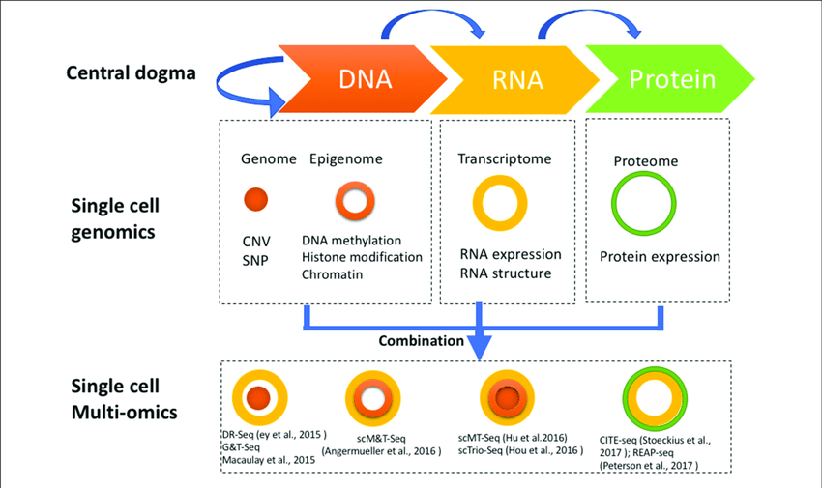
What kind of data do single cells provide?
Hu, Y et al. Front
Cell Dev. Biol, 2018
Notes:
DNA (point mutations, copy number variants)
RNA (transcriptome, post-transcript splicing)
Protein (cell surface markers, enzymatic activity)
Regulatory (epigenetic marks, chromatin availability)
Spatial information (location in context to whole tissue)
Strategies for multi-omics profiling of single cells. Three major types of molecules relating to biological central dogma (Top). Single cell genomics methods profiling the genome, epigenome, transcriptome, and proteome are shown by different shapes with variable colors (Middle). Single cell multi-omics methods are built by combining different single cell sequencing methods to simultaneously profile multiple types of molecules of a single cell genome wide (Bottom). For example, G&T-seq was built by combining genome (orange) and transcriptome (yellow) to simultaneously detect DNA and RNA of the same cell genome wide.
Source publication

Slide 5
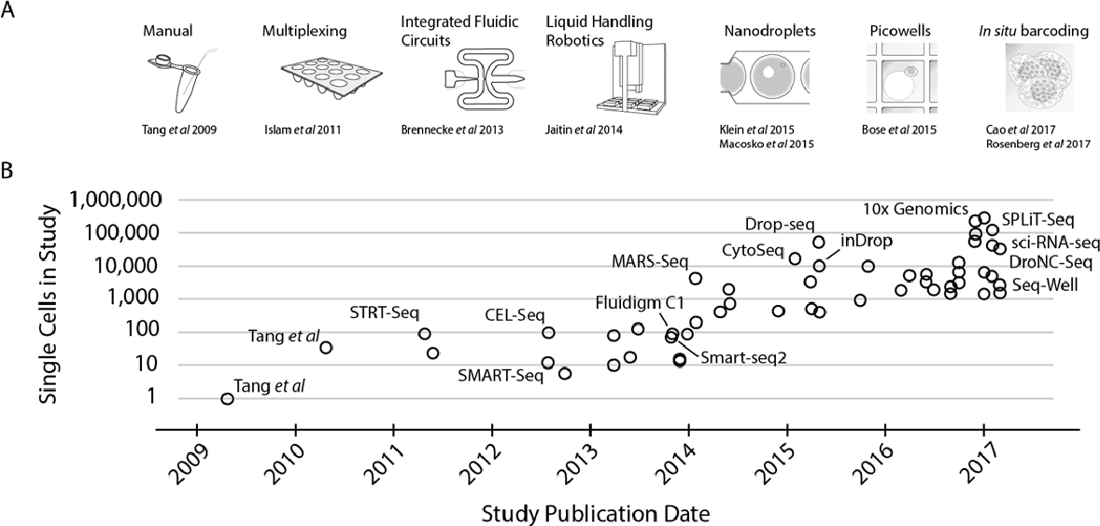
Exponential rise of single cell RNA-seq (scRNA-seq)
Svensson, V et al. Nat. Protoc., 2018
Notes:
In the last years, single cell RNA-seq technologies have grown exponentially. Researchers and engineers in immunology, stem cell biology, and cancer biology have embraced pioneering single cell technologies, and as a result, have revolutionized single cell genomics.
ANIMATION: on click, blue dot appears over drop-seq to highlight where it is, and could use to transition to next slide about Drop-seq
“Figure 1: Scaling of scRNA-seq experiments [CROPPED OUT A] (A) Key technologies allowing jumps in experimental scale. A jump to ~100 cells was enabled by sample multiplexing, a jump to ~1,000 cells by large scale studies using integrated fluidic circuits (IFCs), followed by a jump to several thousands using liquid handling robotics. Further order of magnitude jumps were enabled by random capture technologies through nanodroplets and picowell technologies. Recent studies have employed in situ barcoding to reach the next order of magnitude. (B) Cell numbers reported in representative publications by publication date. Key technologies and protocols are marked, and a full table with corresponding numbers is available in Supplementary Table 1”

Slide 6
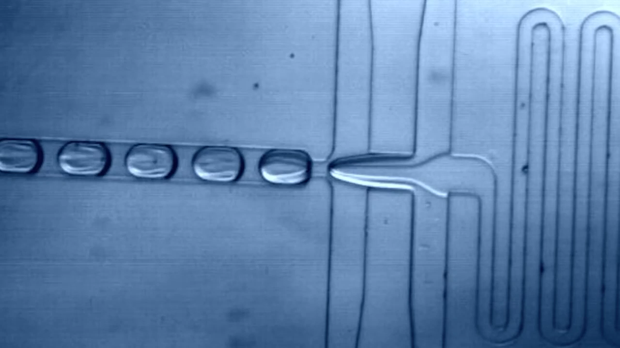
Drop-seq microfluidics
Barcoded
beads
Cells and beads with DNA tags are incorporated together to form drop
Cells
Macosko E.Z, Basu A, et al. Cell, 2015

Slide 7
Expanding single cell multi-omics methodologies
Hu, Y et al. Front
Cell Dev. Biol, 2018
Notes:
DNA +RNA = G&T seq, dr-seq
Protein + RNA = CITE-seq
Regulatory (epigenetic) + RNA = scM&T-seq
(and not included in the image above: Spatial information +RNA)

Slide 8
Rise of single cell multiplexed data
Capturing multiplexed information allows for deeper understanding cellular identity
Overcomes technical limitations of current single cell resolution
e.g., drop-out events due low signal
Notes:
A cell’s identity is reflected by its molecular profile, and this profile is created by the interaction of multiple factors. Factors, like the environment, cell development, cell cycle, spatial context, will all continue to interact and shape cell’s physiology.

Slide 9
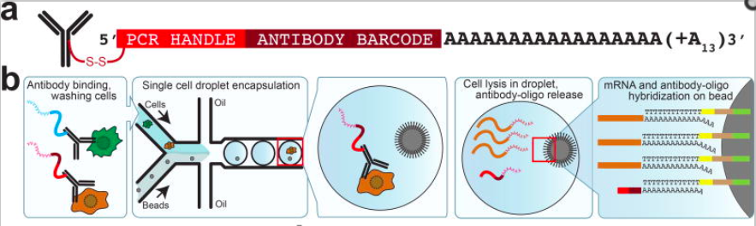
CITE-seq (Cellular Indexing of Transcriptomes and Epitopes by sequencing)
Stoeckius, M et al.
Nature Methods,
2017
Notes:
Cite-seq utilizes index sorting, for cellular isolation, by using an antibody tagged with a DNA barcode. The barcode allows for tracking individual cells after RNA sequencing. By combining cell surface marker tagging and sequencing, one can couple protein information with transcriptome activity.
FIGURE LEGEND “(a) Illustration of the DNA-barcoded antibodies used in CITE-seq. (b) Schematic representation of CITE-seq in combination with Drop-seq¹. Cells are incubated with antibodies, washed and passed through a microfluidic chip where a single cell and one bead are occasionally encapsulated in the same droplet. After cell lysis mRNAs and antibody-oligos anneal to oligos on Drop-seq beads, linking cell barcodes with cellular transcripts and antibody-derived oligos.
REMOVED (c – e) Analysis of mixtures of mouse and human cells that were incubated with oligo-tagged-antibodies specific for either human or mouse cell-surface markers (integrin beta CD29) and processed by Drop-seq. (c) Quantification of the number of human and mouse transcripts associating to each cell barcode. Green: >90% human reads, Red: >90% mouse reads, Blue: >10% human and mouse (multiplet). (d) Quantification of antibody tags (ADTs) associated with each cell barcode. Points are colored based on species classifications using transcripts in (c). (e) Quantification of human, mouse or mixed-cell barcodes based on RNA transcripts, or ADTs.”

Slide 10
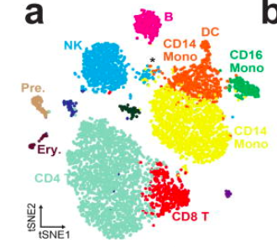
CITE-seq: global gene expression among cord blood mononuclear cells
Each node is a cell
Cells are grouped in neighborhoods of similar cells
Gene expression is correlated with cell type
Stoeckius, M et al.
Nature Methods,
2017
Notes:
An example of the data from CITE-seq was a characterization of cord blood mononuclear cells which were sorted by antibody tags of cell surface markers. Cells demonstrate gene expression clustering
FIGURE LEGEND
“CITE-seq allows detailed multimodal characterization of cord blood mononuclear cells(a) Clustering of 8,005 CITE-seq single-cell expression profiles of CBMCs reveals distinct cell populations based on transcriptome. The plot shows a two-dimensional representation (tSNE) of global gene expression relationships among all cells. Major cell types in cord blood can be discerned based on marker gene expression (Supplementary Fig. 4). Putative doublets co-expressing multiple lineage markers (*) are indicated. The mouse control cell population was excluded from the clustering.”
(b) mRNA (blue) and corresponding ADT (green) signal for the CITE-seq antibody panel projected on the tSNE plot from panel a. Darker shading corresponds to higher levels measured.

Slide 11
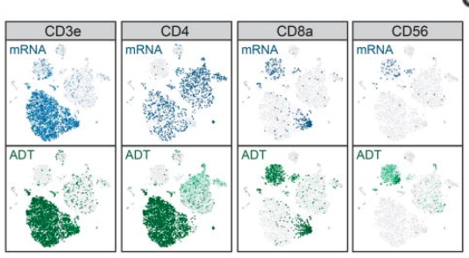
CITE-seq: global gene expression among cord blood mononuclear cell type is structured
Gene expression
Antibody tag
Stoeckius, M et al.
Nature Methods,
2017
Notes:
An example of the data from CITE-seq was a characterization of cord blood mononuclear cells which were sorted by antibody tags of cell surface markers. Cells demonstrate gene expression clustering with cell type.
(b) mRNA (blue) and corresponding ADT (green) signal for the CITE-seq antibody panel projected on the tSNE plot from panel a. Darker shading corresponds to higher levels measured.
ADT = antibody tag

Slide 12
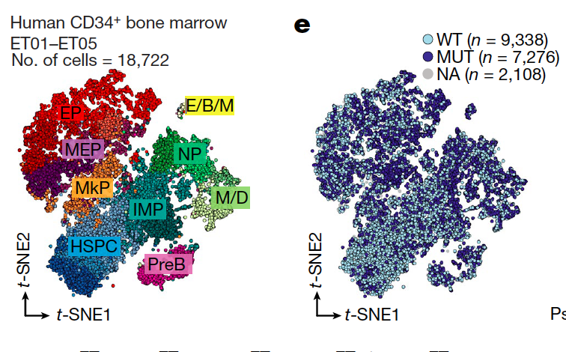
GoT (Genotyping of Transcriptome sequencing) differentiates mixed cell population by genotyping
Cells are grouped by transcriptional information
Mutant neoplasms cannot be distinguished from wild-type by RNA alone
Nam, A. S et al.
Nature, 2019
Notes:
So, CITE-seq relies on already knowing which cell surface markers are present in the population you want to study. What if we don’t know or have access to reliable cell surface markers to identify cells?
Genotyping of Transcriptomes is a multiplex method that couples single cell genotyping and high-throughput RNA-seq. In this very recent work from this year from both Peter Smibert and Dan Landeau’s groups from the New York Genome Center, they utilized this method to gain insight to the how haematopoiesis lineage development is disrupted due to somatic mutations, which leads to cancerous state.
This technique analyzes the link between genetic mutations and cellular identities, which will help unravel the underlying programs that enable clonal expansions and evolution in cancer.
Specifically, they profiled ~38,000 CD34+ bone marrow cells from patients with CALR-mutated myeloproliferative neoplasms from five patients. [THE FIGURE IN THE SLIDE] Notably, mutated cells did not form novel independent clusters, which confirms that scRNA-seq alone cannot distinguish mutant from wild-type cells and demonstrates that CALR mutations in essential thrombocythaemia affect the entire haematopoietic differentiation hierarchy.
HSPC: Hematopoietic stem and progenitor cells; E/B/M, eosinophil, basophil and mast cell progenitors; EP, erythroid
progenitors; IMP, immature myeloid progenitors; M/D, monocyte–dendritic
cell progenitors; MEP, megakaryocytic–erythroid progenitors; MkP,
megakaryocytic progenitors; NP, neutrophil progenitors; PreB, precursor B
cells; NA, not assignable

Slide 13
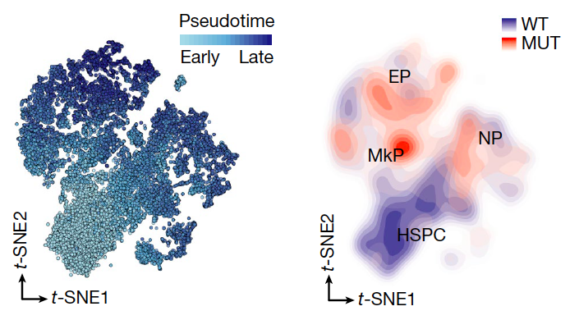
GoT (Genotyping of Transcriptome sequencing) differentiates mixed cell population by genotyping
Higher frequency of mutation is found in progenitor, not HSPCs
Detected by genotyping within same progenitor cluster
Nam, A. S et al.
Nature, 2019
Notes:
Using pseudotime and genotyping progenitor clusters, they measured an increase of the mutation that is propagated in lineage progenitors in a higher frequency than in the HSPC (hematopoietic stem cell and progenitor cells)
The use of high-throughput single-cell genotypic and transcriptomic data underscored the dependency of somatic mutations on cell identity in human haematopoiesis, and enabled them to superimpose the native differentiation tree with a tree corrupted by somatic mutations.

Slide 14
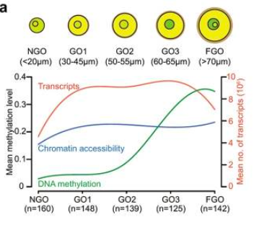
Triple-omic data with iscCOOL-seq/scNMT-seq
Single cell
RNA-seq
DNA accessibility
DNA methylation
Gu C, et al. Cell Res. 2019
Notes:
A unique method combined three modes of data: RNA, chromatin availability and methylation. Fan Guo’s group at Sichuan University in China developed a single-cell multi-omics sequencing technology (single-cell COOL-seq) that can analyze the chromatin state/nucleosome positioning, DNA methylation, copy number variation and ploidy simultaneously from the same individual mammalian cell
They used this method to understand the molecular landscape of growing mouse oocytes. Mature oocytes of mammals have the ability to reprogram sperm and somatic nuclei to produce new offspring or cloned individuals. During the maturation of mammalian oocytes, its epigenetic modification (such as DNA methylation) and chromatin status also change dramatically. However, the relationship between chromatin remodeling characteristics and DNA methylation and chromatin status in this process is not very clear.
Single-cell analysis of both chromatin accessibility and DNA methylation in growing mouse oocytes. a A diagram of the number and diameters of growing oocytes used at each stage. The lower panel shows the mean of chromatin accessibility (GCH methylation level), DNA methylation (WCG methylation level) and the abundance of transcripts at each stage.
In the process of oocytes growth and maturation, single oocytes undergoes drastic changes in chromatin state before and after the initiation of growth, and the transcription group also go through significant changes accordingly; however, the overall DNA methylation level of the genome is still below 5% before and after the initiation of oocytes growth, and there is no significant increase (figure below),which suggested that non-growing oocytes have unique gene ex-x-pression and chromatin accessibility.

Slide 15
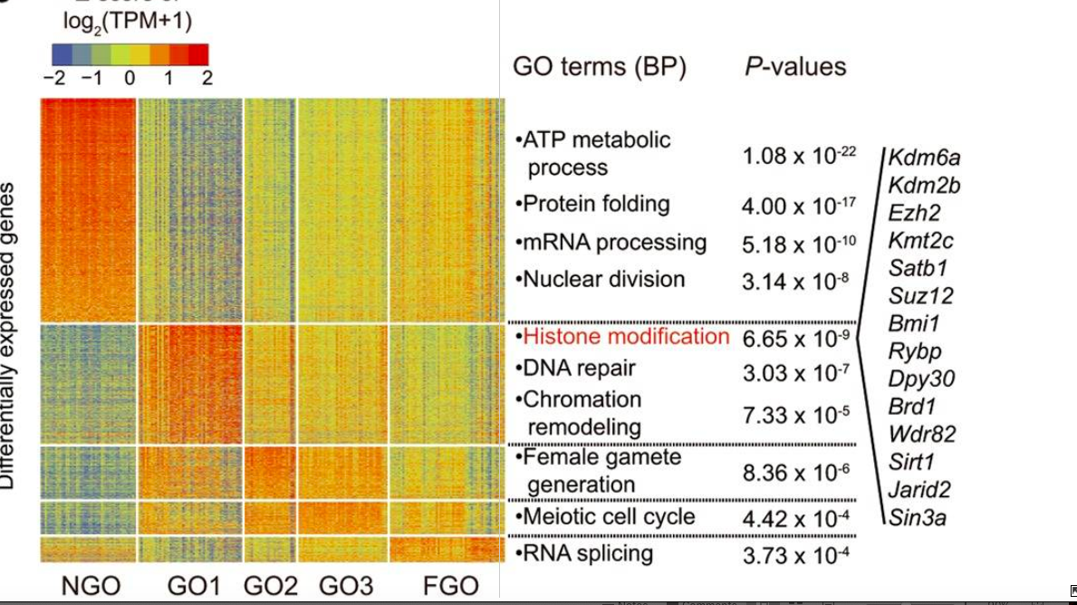
Differential gene expression correlates with cell growth state
Histone modification is most highly expressed during GO1
Gu C, et al. Cell Res. 2019
Notes:
Advances in single-cell epigenome sequencing technologies, which can detect chromatin modifications or structures at single-cell resolution, have greatly facilitated our exploration of the epigenetic heterogeneity of cell populations. However, in general, methylome and chromatin accessibility data are generally far less predictive of cellular behaviour than transcriptome but are complementary to it.
H

Slide 16
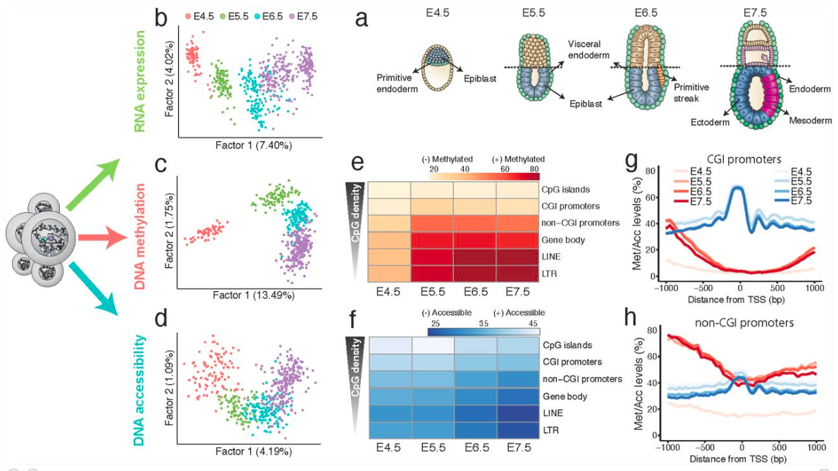
scNMT-seq: single-cell nucleosome, methylation and transcription sequencing
Single cell triple-omics profiling of mouse gastrulation
Argelaguet R, et al. Preprint. Jan 2019
Notes:
Single cell triple-omics profiling of mouse gastrulation.(a)Schematic of the developing mouse embryo, with stages and lineages analysed annotated. (b)Factor analysis projection of RNA expression data. (c)Factor analysis projection of DNA methylation data, quantified using non-overlapping 5kb windows along the genome. (d)Factor analysis projection of chromatin accessibility data, quantified using non-overlapping 100bp windows along the genome. All three molecular layers distinguish developmental stage.

Slide 17
sc-seq reveals a hierarchical epigenetic landscape during mammalian germ layer specification
Zhu G, et al. Nat. Biotech. 2018
Notes:
Single cell triple-omics profiling of mouse gastrulation.( (e)Heatmap of DNA methylation levels (%) per stage and genomic context. (f)Heatmap of chromatin accessibility levels (%) per stage and genomic context. (g,h) DNA methylation (red) and chromatin accessibility (blue) profiles of (g) CGI promoters and (h) non-CGI promoters. Shown are genome-wide profiles, calculated using running averages of DNA methylation (red) and the chromatin accessibility (blue) (consecutive non-overlapping 50bp windows) across all cells within a stage.
Exit from pluripotency is associated with a global repressive epigenetic landscape, driven by a sharp gain of DNA methylation and a gradual decrease of chromatin accessibility.
DNA methylation and chromatin accessibility changes in enhancers, but not in promoters, are associated with germ layer formation.

Slide 18
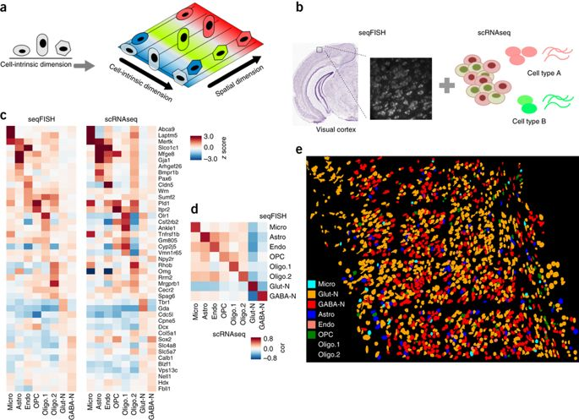
scRNA-seq and seqFISH
Zhu G, et al. Nat. Biotech. 2018
Notes:
Lastly, traditional FISH (fluorescent in situ hybridization)
Figure 1 Overall goal of the project and cell type prediction in seqFISH data. (a) Cellular heterogeneity is driven by both cell type (indicated by shape) and environmental factors (indicated by colors). scRNAseq-based studies can only detect cell-type-related variation, as spatial information is lost. (b) Our goal was to decompose the contributions of each factor by developing methods to integrate scRNAseq and seqFISH data. (c) Prediction results evaluated by the comparison of cell type average expression profile across technologies for eight major cell types. Values represent expression z scores. SVM was tuned for the parameter C, which was set to 1 Å~ 10−5 to optimize the cross-platform cell type to cell type correlations. The major cell types in the scRNAseq data set (Astro, n = 43 cells; Endo, n = 29; GABA-N, n = 761; Glut-N, n = 812; Micro, n = 22; OPC, n = 19; Oligo.1, n = 6; Oligo.2, n = 31) mapped to 97, 11, 556, 859, 22, 8, 21 and 23 cells in the seqFISH data set. (d) Pearson correlation between reference and predicted cell type averages ranged from 0.75 to 0.95. (e) Integration of seqFISH and scRNAseq data (illustrated in b) enabled cell type mapping with spatial information in the adult mouse visual cortex. Each cell type is labeled by a different color. Cell shape information was obtained from segmentation of cells from images (Online Methods). One mouse brain was assayed by seqFISH because of experimental cost.
Spatial and non-spatial single cell transcriptional data for the adult mouse cortex
seqFISH data of 125 genes from Zhu et al 2018
scRNA-seq data for ~1,600 cells from Tasic et al.
Combined data enable cell type mapping with spatial information of non-spatial, high-resolution transcriptional data

Slide 19
Challenges with seqFISH data
Can scRNA-seq data be overlaid onto seqFISH for resolution enhancement?
Could higher resolution imaging-based transcriptional data be used to overcome drop-out events in scRNA-seq?
Do signatures of cellular co-localization or spatial coordinates in non-spatial scRNA-seq data?
For seqFISH data:
Emily Davis-Marcisak (Fertig lab),
Guocheng Yuan, and Elana Fertig

